Slide 1
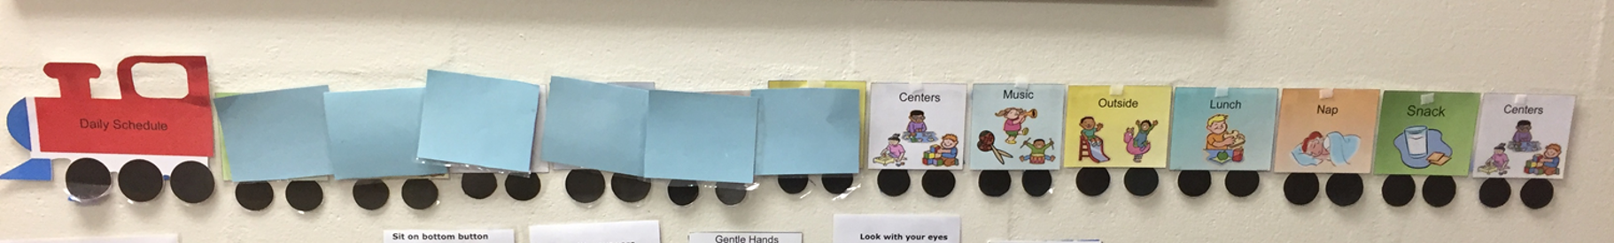
Schedules & Routines
Notes:
Schedules are the gold standard in early childhood education. They provide a predictable structure to the day and teach children what is expected of them and reminds them what they should be doing.

Slide 2
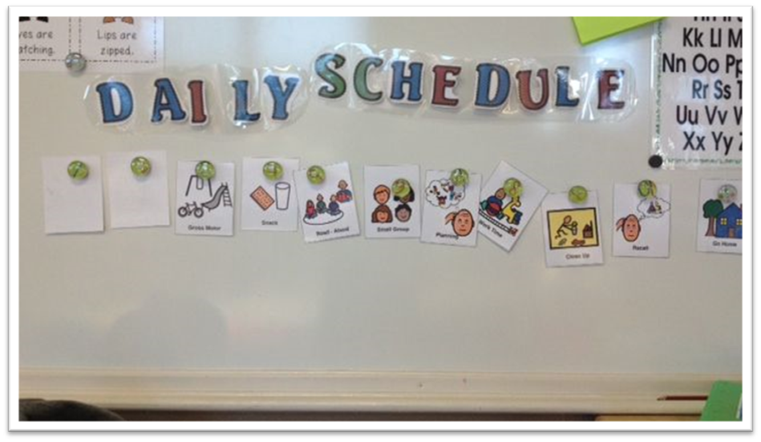
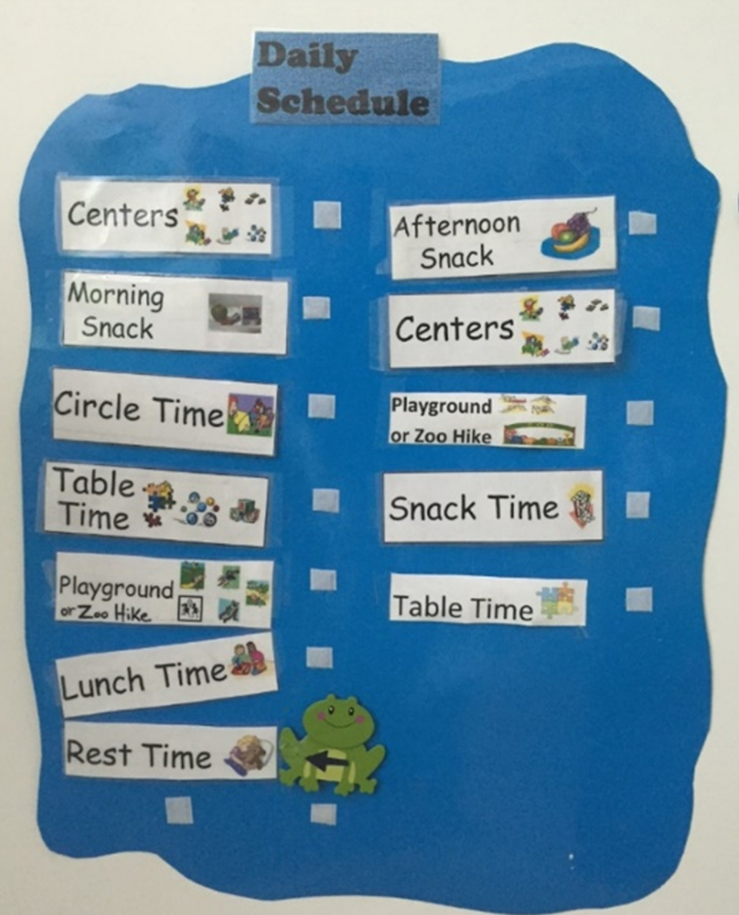
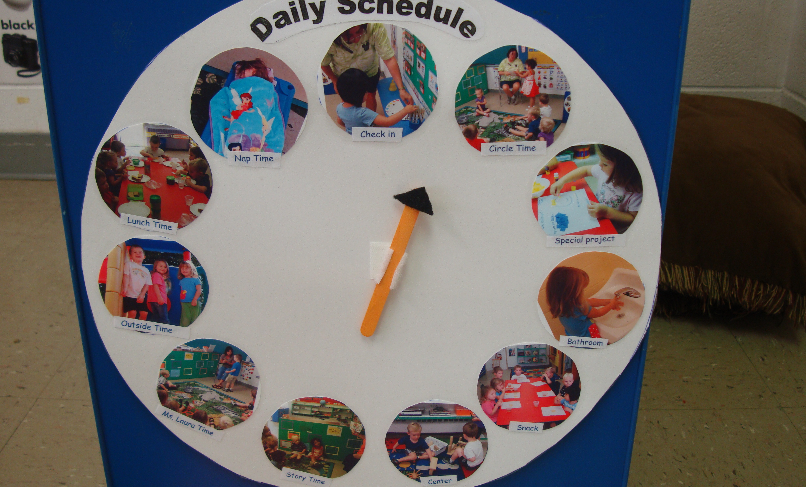
Gold Standard of Early Childhood Education
1. Influence children’s emotional, cognitive, & social development.
2. Help children feel safe and secure.
3. Help children understand expectations of the environment.
4. Support higher rates of engagement.
Notes:
Why are schedules the gold standard for early childhood education? Well… they… read slide. Let’s look at the pivotal practices for how to use a visual schedule.
When we are serving young children who have experienced trauma or who are currently in a traumatic event, like Alice- we want our classroom community to be one of their safe places. A set schedule & routine that the child knows provides that safe and secure feeling that supports the child’s social-emotional development.

Slide 3
Posted at children’s level.
Physically show change in the schedule by covering up or removing routines & activities as they are completed.
Review EVERY day!
Refer to schedule multiple times a day.
Modify the schedule when changes occur.
Notes:
The pivotal practices for using a visual schedule…
Posted at child’s level: children must be able to see the schedule and manipulate the schedule. A schedule that is above eye level is for the adult’s benefit only.
Physically show change…: I just love this train schedule because it is so easy to manipulate. Children use a post-it to physically show the change in their daily schedule.
Review & refer: everyday review the schedule and refer to the schedule many times a day! When could you review the schedule? Illicit responses. Yes- and you refer to the schedule as transitions come. “We are finishing up center play and getting ready for snack.”
Modify: if there is a significant change in the schedule- a special event or it’s raining and there is no outside recess- modify the schedule to visually show children the change.

Slide 4

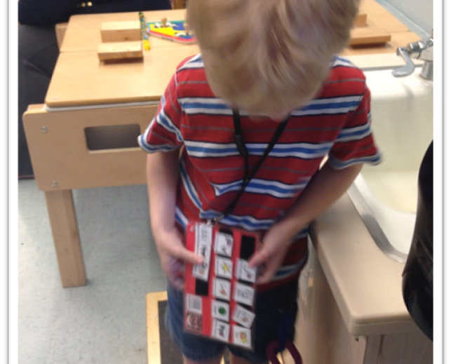
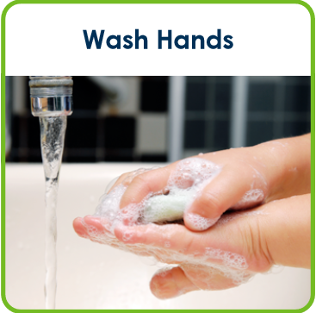

Individualized Schedules
Notes:
Some children need more individualized schedules, like you see in this picture of the little boy. And for other children, the routine needs to be broken down into smaller steps. This is where a first/then card can be very helpful!
(expand as needed)
If you have a child at your center who you think would benefit from an individualized schedule or a first/then schedule- I’ll be happy to help with that during a on-site mentoring session!

Slide 5
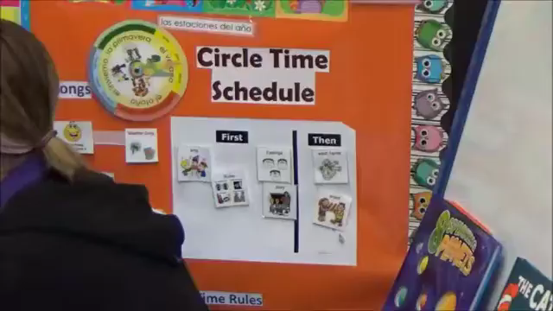
Notes:
Let’s look at a schedule review in action.
Get feedback from group about the video.

Slide 6
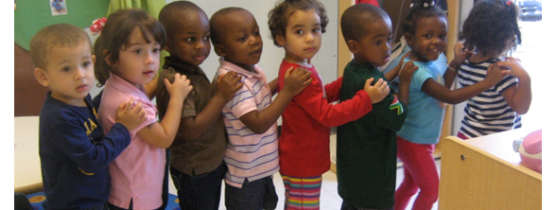
Transitions
Notes:
Part of every schedule and every early childhood classroom are transitions. Let’s look at pivotal and best practices for transitions!

Slide 7
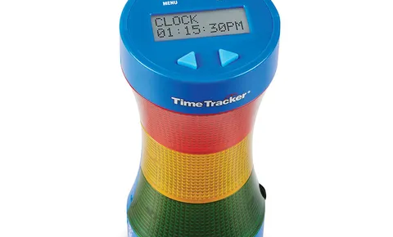
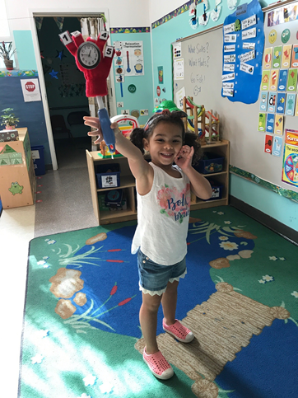
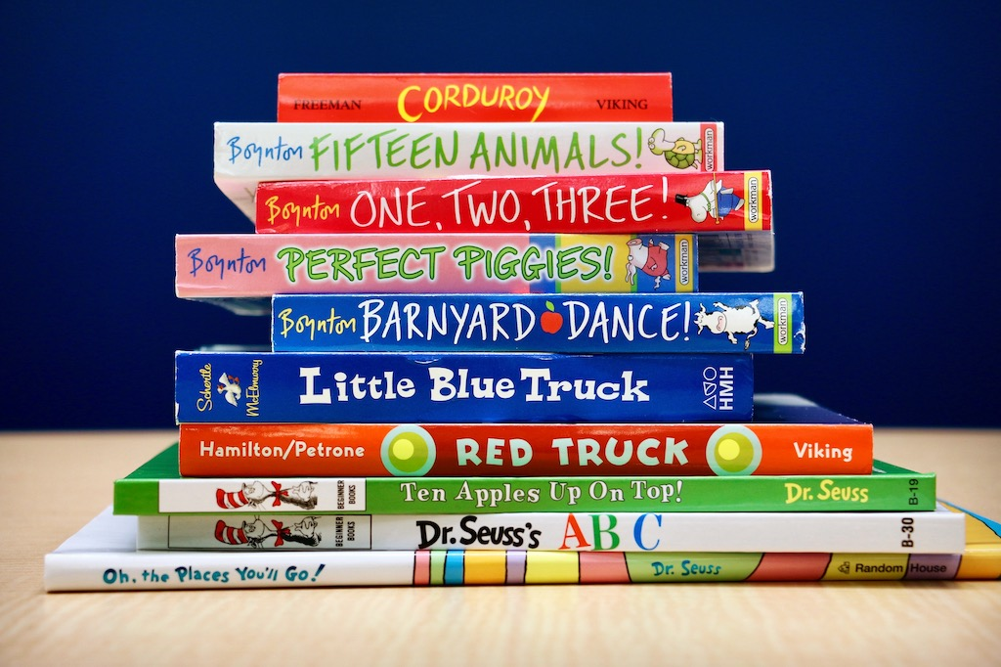
Pivotal Practices for Transitions
Provide whole class warning.
2. Use a transition strategy to engage all children.
3. Teach the specific steps and expectations for the transition.
4. Provide positive and descriptive feedback to children.
*** Provide individual support to children who have difficulty transitioning.
Notes:
Transitions occur when children move from one activity to another. For some young children, moving from one activity to another (e.g., bus to classroom, centers to circle time, art time to
lunch) results in confusion, frustration, and/or challenging behaviors. Planning for transitions includes developing routines and teaching children what to expect during the transition.
Transition routines help to prepare children for transitions, engages them in the change that is taking place, and helps them to move smoothly to the next activity.
The more children can predict and participate in the schedule and activities of the day, the less likely it is that challenging behavior will occur and the more likely it is they will engage in transitions. Let’s review the pivotal practices for transitions:
(expand…)
Provide whole class warning: timers and other visuals are great for this- picture of the timer and the little girl’s job that day is to help provide the 5, 3, & 2 minute warning.
2. Use a transition strategy to engage all children: Do y’all remember Barney? He was the master of transition when he introduced the world to his clean-up song. It’s simple and catchy. You don’t have to have anything elaborate, but use a simple song, chant, or game to engage children in transitions.
3. Teach the specific steps and expectations for the transition: do the children know what is expected of them before, during, and after the transition? Do they know where to stand or what to do? Watch the children in your classroom- if they are wandering around- if they are not in the correct the place- they might be showing you that they don’t understand and that they don’t know what to do. Teach them the steps & expectations!
4. Provide positive and descriptive feedback to children: ALWAYS- provide positive & descriptive feedback as children complete task, follow directions, are engaging in positive behavior…
*** Most importantly! Provide individual support to children who have difficulty transitioning. This could include gently guiding the child or using a transition object. Transition objects help develop the executive skills and help sustain children’s attention.
Time to go outside, give the child a job to do. Maybe he brings the box of chalk.
Time to wash hands. He carries the soap to the sink.
Time for circle time. The child carries today’s storybook to circle.
The object helps to direct the child’s attention to the task at hand, supporting a smooth transition to the next activity.

Slide 8
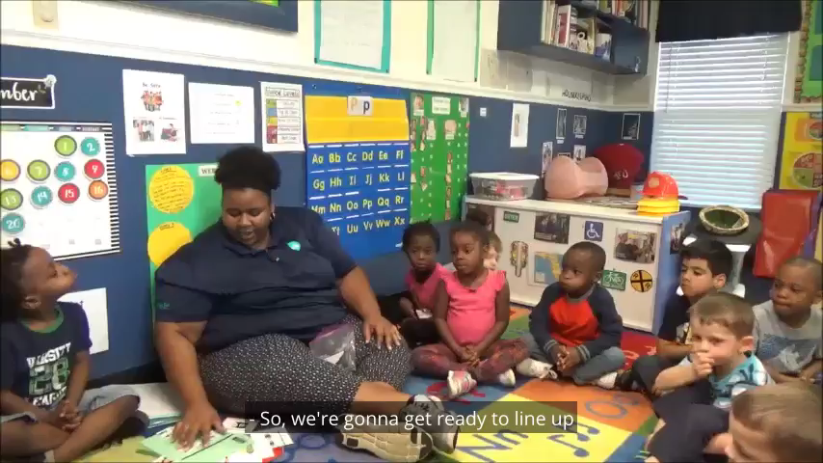
Notes:
Okay- I’m going to share with y’all my favorite transition video. It’s fun! Let’s watch…
Feedback and comments:
I just love how this teacher moves this along… she calls several children at once. A friend who is having a hard time deciding- she’s kind to him and says- he’s still thinking about it. I love that because- some children take longer to process questions and that is okay!

Slide 9
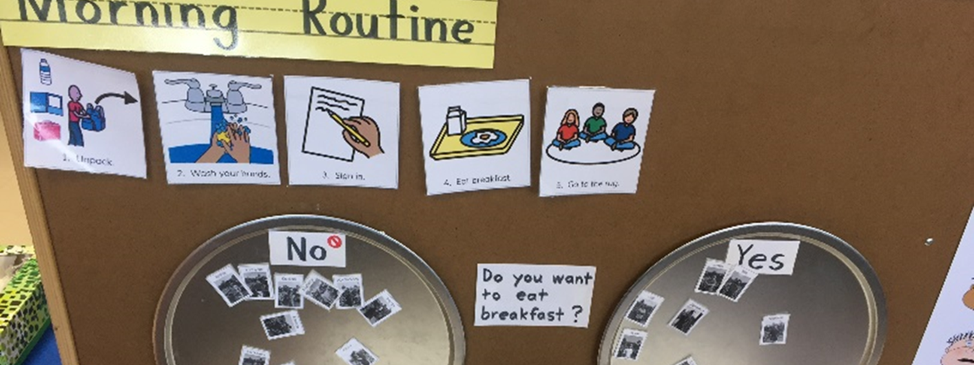
Routines
Notes:
Classrooms with consistent schedules and routines support children’s understanding of the learning environment. Preschool classroom activities include such things as arrival, bathroom
time, naptime, circle time, center time, meal or snack, and dismissal. These preschool activities are necessary and helpful for building a consistent, predictable, and organized classroom environment.
Like with schedules, children who know the schedule and routines of the classroom tend to be more attentive & engaged, feel secure, demonstrate independence, & understand expectations.

Slide 10
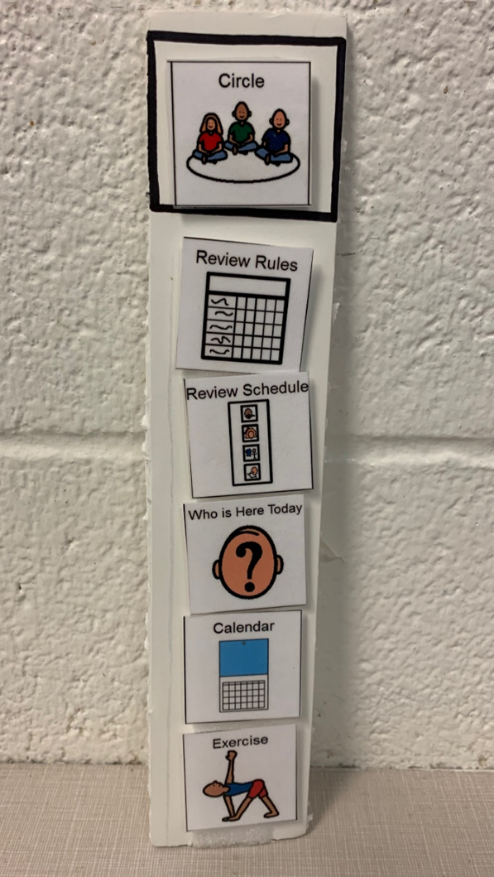
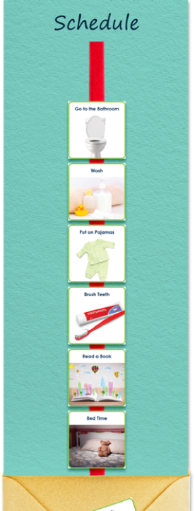
Notes:
Do y’all remember this arrival routine? Play again for participants… this routine is a part of the classroom’s morning routine. Not only does it promote community, but the children know exactly what to do because it has become a routine!
These other two pictures are great visuals for specific routines.
1- Activity- Circle Time – Routine- Review Rules, Review Schedule, Who Came to School, Calendar, and then Exercise.
2- Activity- Arrival- Routine- unpack, wash hands, sign-in, eat, gather for circle

